Slide 1
ORAN- MESSAGE FLOW

Slide 2
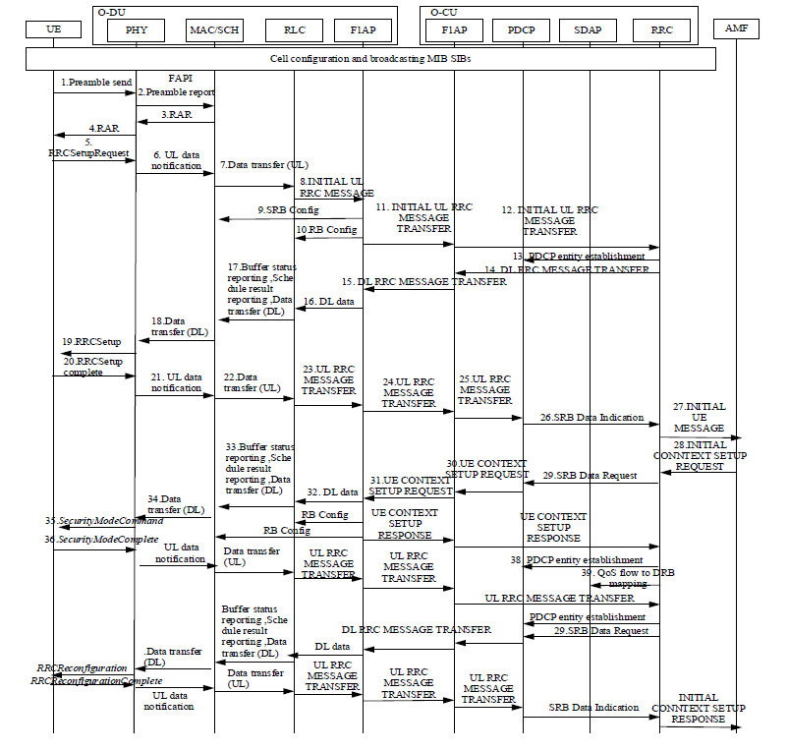

Slide 3
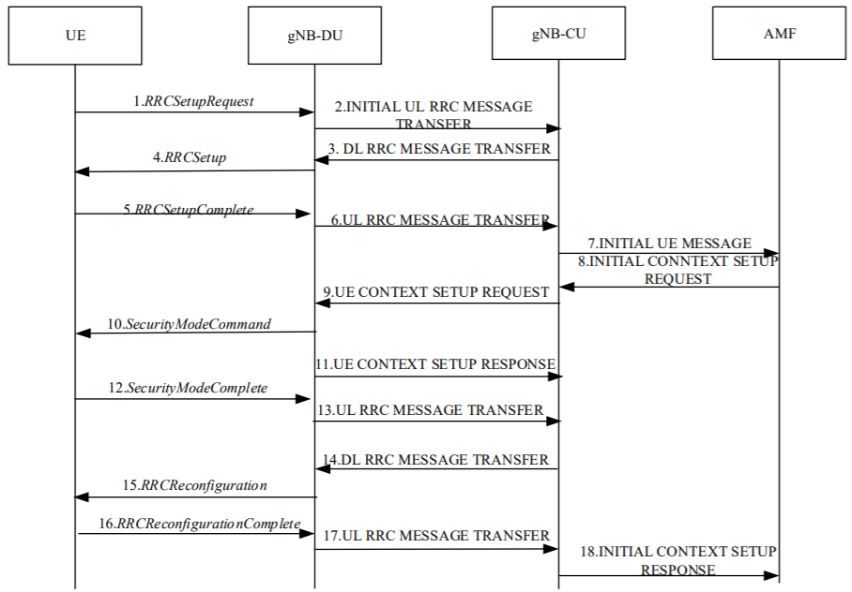
UE Initial Access : 38.401 (NG-RAN Architecture description )
Reference : TS 138 401 - V15.5.0 pg 15

Slide 4
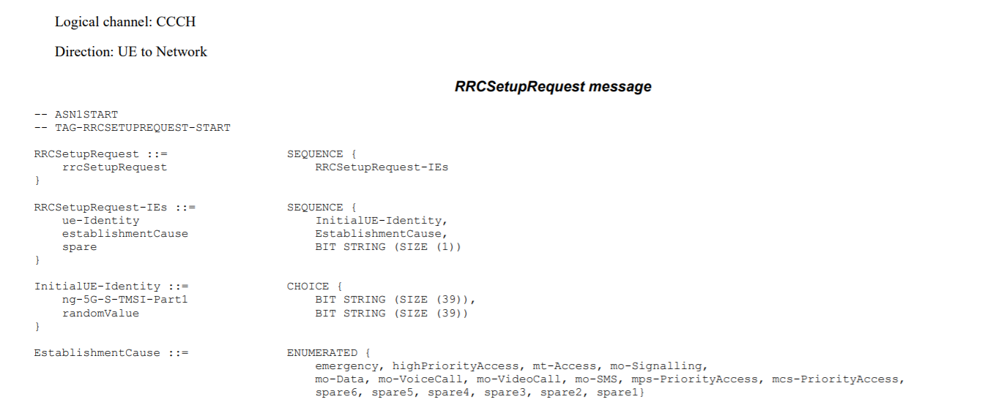
5.
If UE is already registered this is provided by AMF during Paging

Slide 5
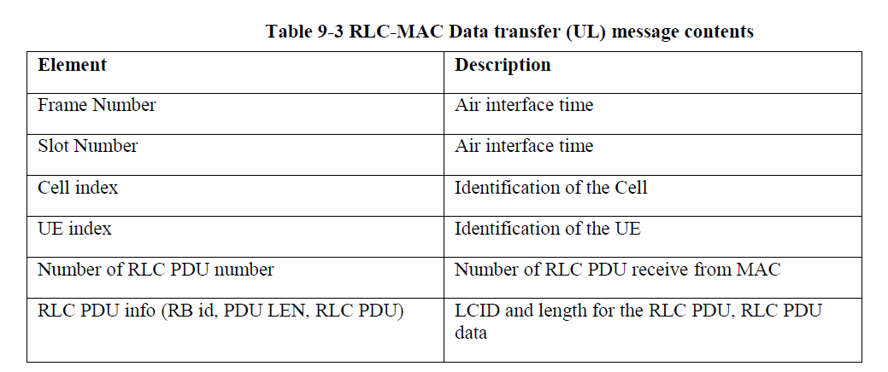

Slide 6
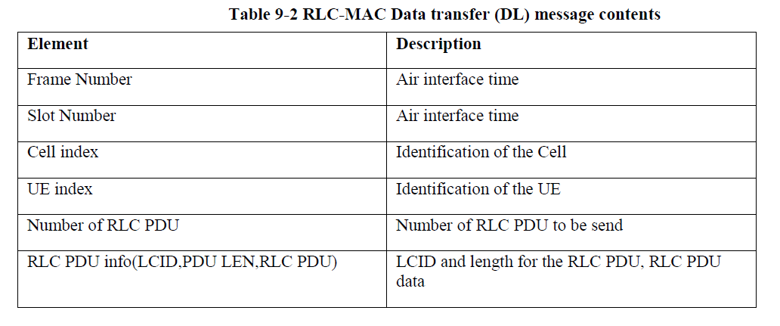
17,18,33,

Slide 7
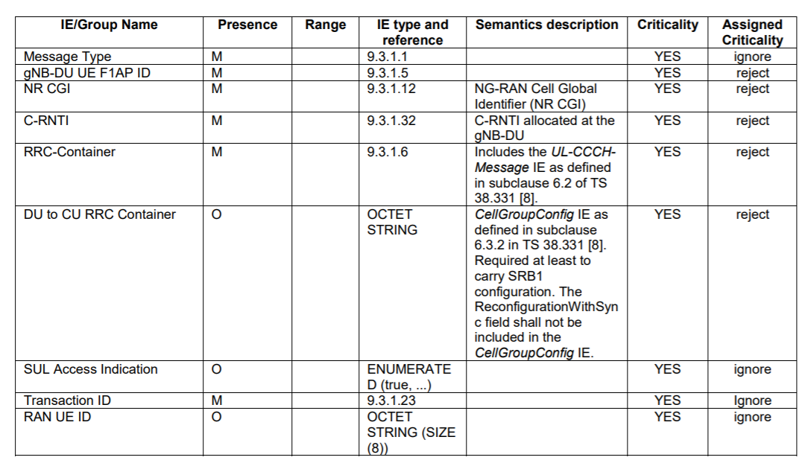
INITIAL UL RRC MESSAGE – (RRC SET-UP REQUEST from UE is carried to RRC gNB through the RRC-Container field in this F1 message)

Slide 8
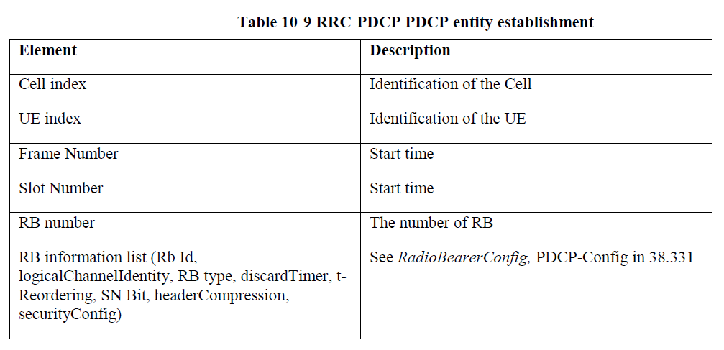
PDCP entity establishment : To establish a PDCP entity for radio bearers

Slide 9
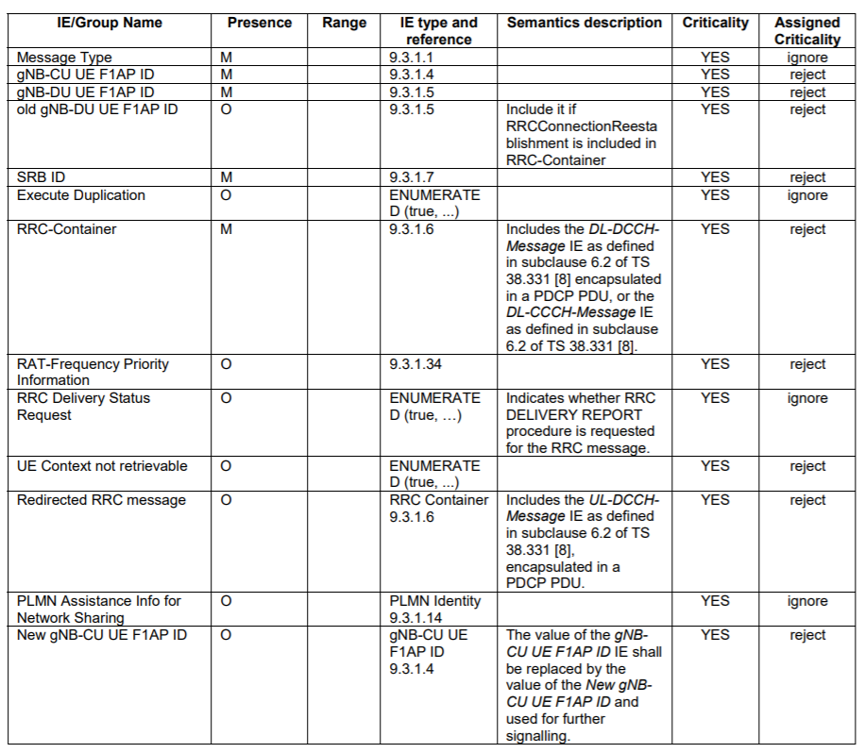
DL RRC MESSAGE TRANSFER

Slide 10
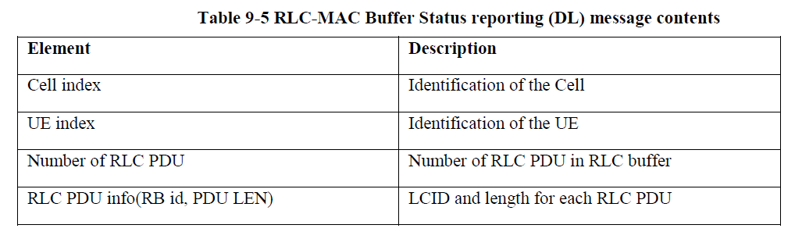

Slide 11
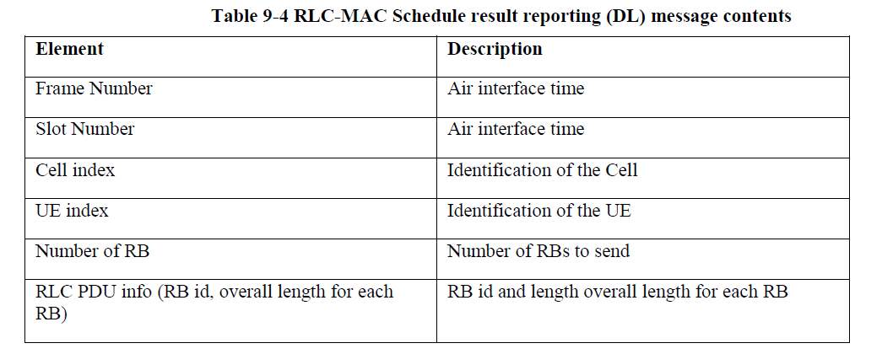

Slide 12
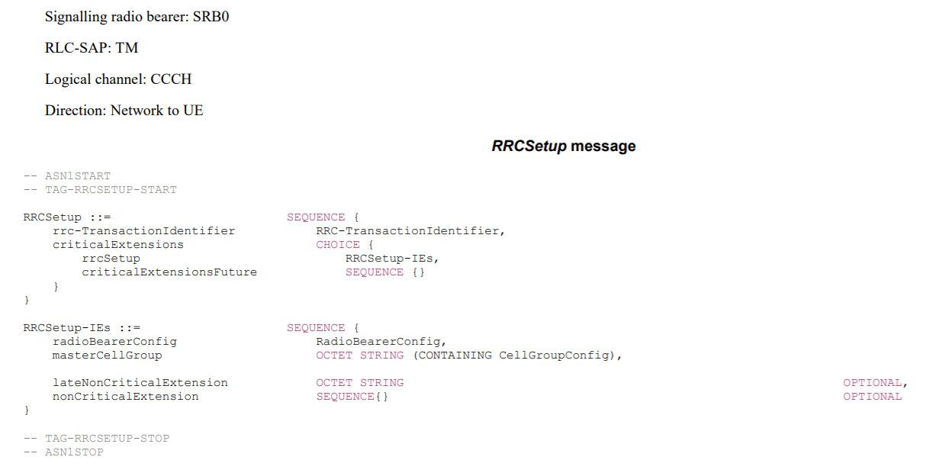

Slide 13
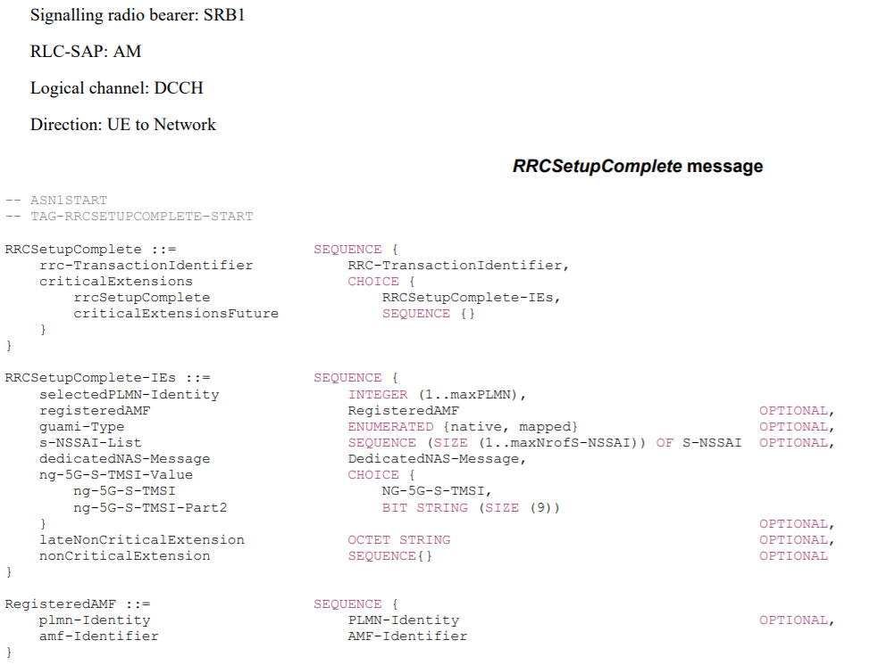
NAS- Message : Registration request (TS – 24.501)

Slide 14
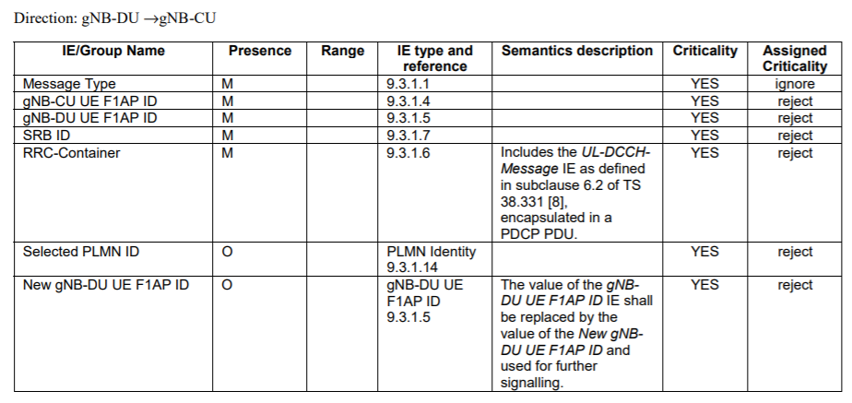
UL RRC MESSAGE TRANSFER

Slide 15
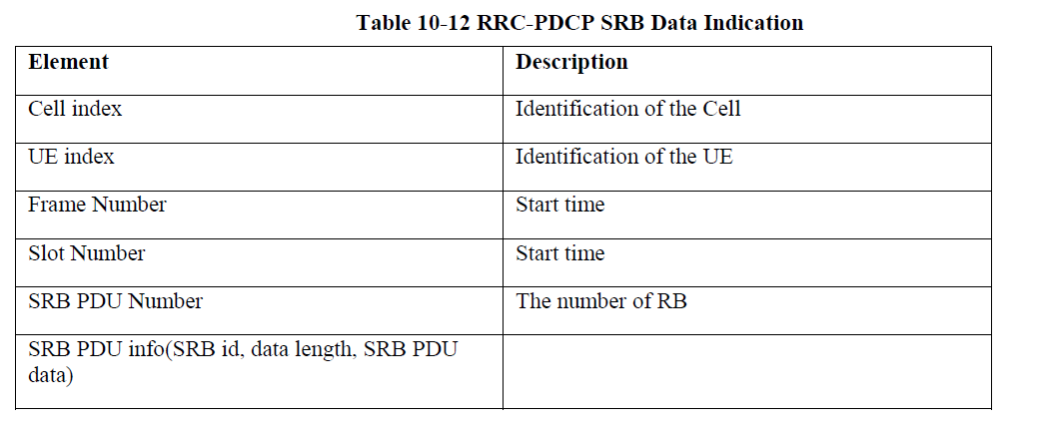

Slide 16
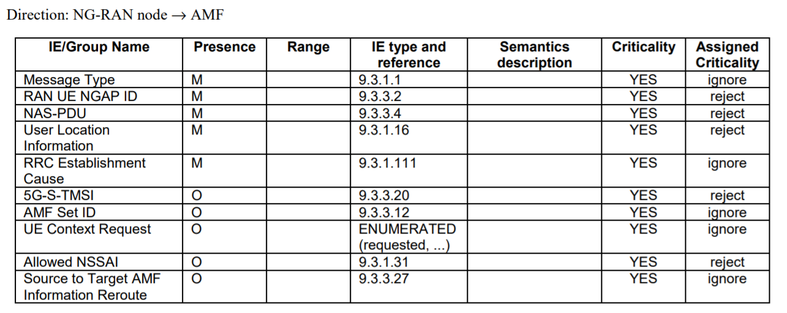
INITIAL UE MESSAGE

Slide 17
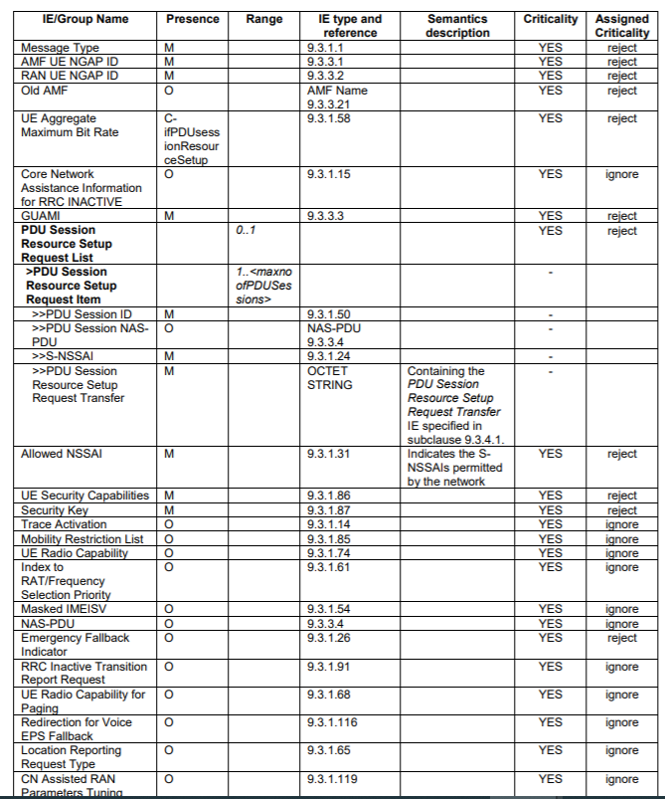
INITIAL CONTEXT SETUP REQUEST
The purpose of the Initial Context Setup procedure is to establish the necessary overall initial UE Context at the NG-RAN node, when required, including PDU session context, the Security Key, Mobility Restriction List, UE Radio Capability and UE Security Capabilities, etc.
The AMF initiates a session setup with the gNB. The message typically contains the Registration Accept NAS message. The message carries one or more PDU Session setup requests. Each PDU session is addressed with the "PDU Session ID".

Slide 18
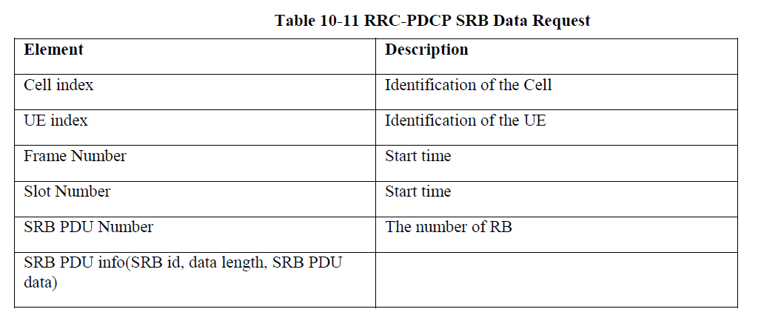

Slide 19
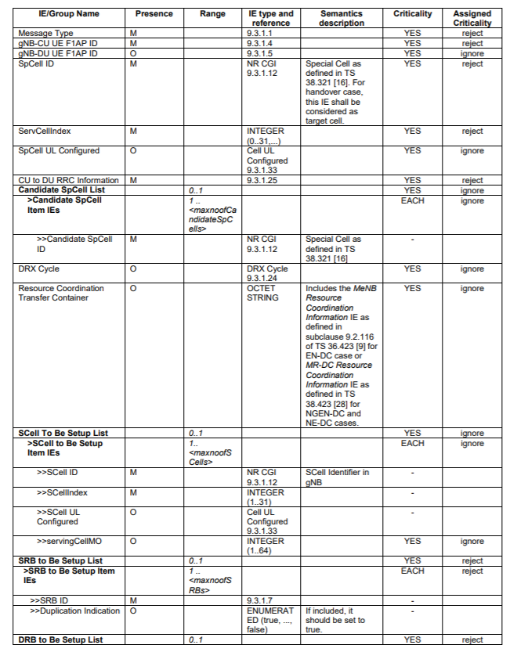
UE CONTEXT SETUP REQUEST (Pg-62)
The purpose of the UE Context Setup procedure is to establish the UE Context including, among others, SRB, and DRB configuration.

Slide 20
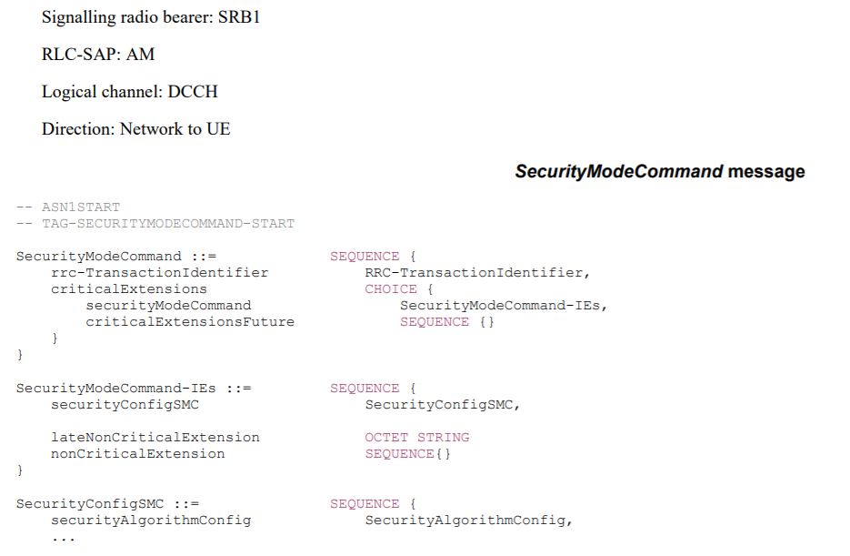
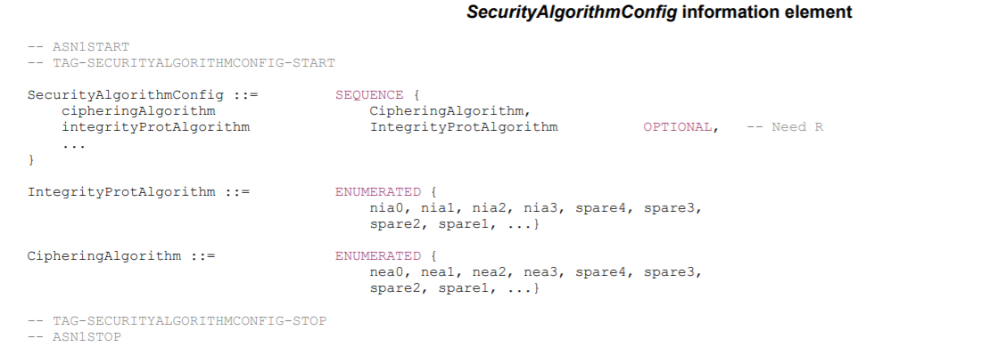

Slide 21
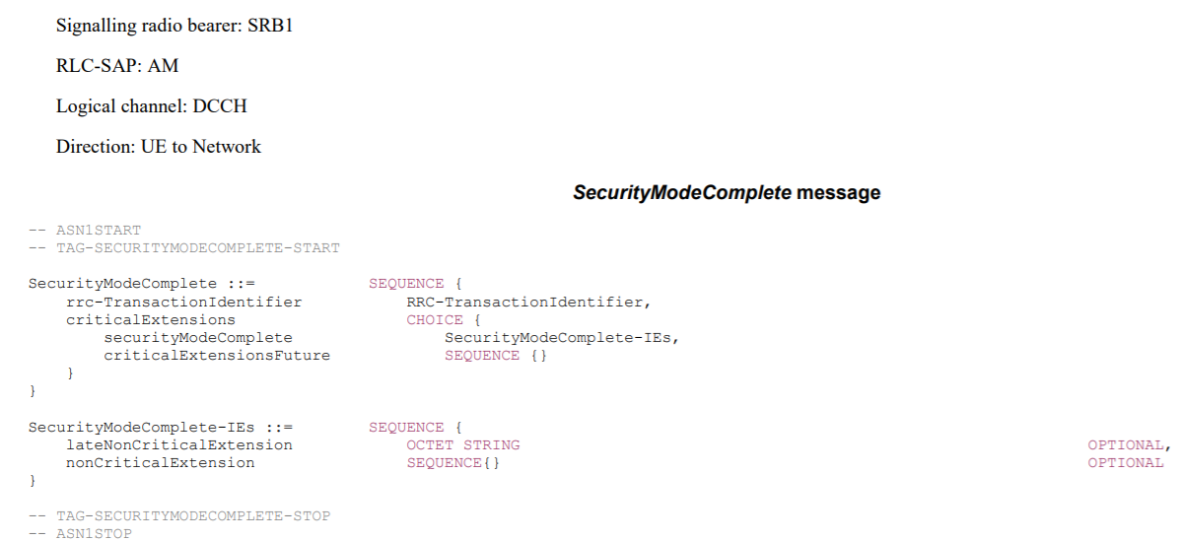

Slide 22
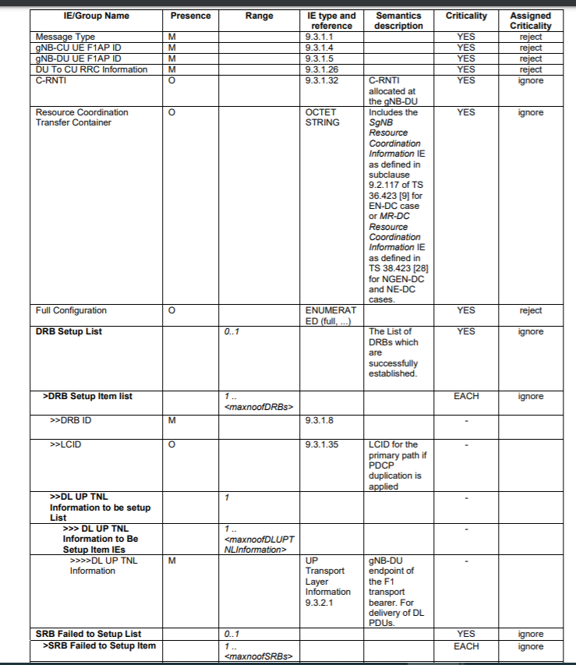
UE CONTEXT SETUP RESPONSE (TS 38.473 Pg 65)

Slide 23
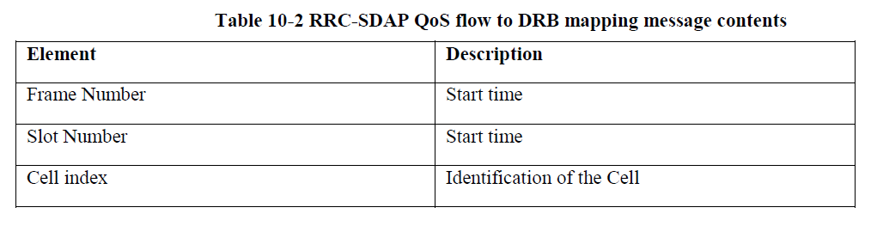
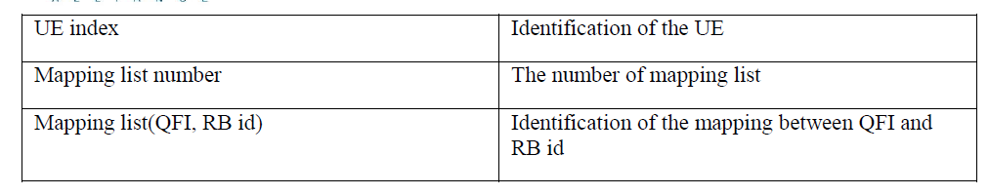
QoS mapping when a DRB is added/modified. RRC indicates in this API if reflective QoS is used.

Slide 24
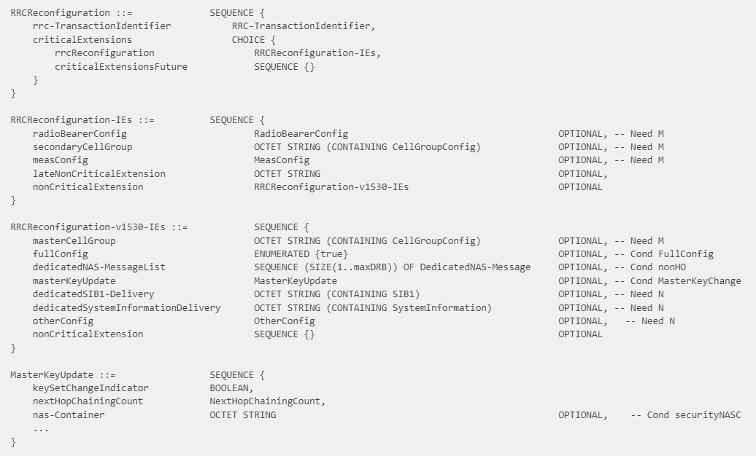
The purpose of this message is to modify an RRC connection, e.g. to establish/modify/release RBs, to perform reconfiguration with sync, to setup/modify/release measurements, to add/modify/release SCells and cell groups. As part of the procedure, NAS dedicated information may be transferred from the Network to the UE

Slide 25
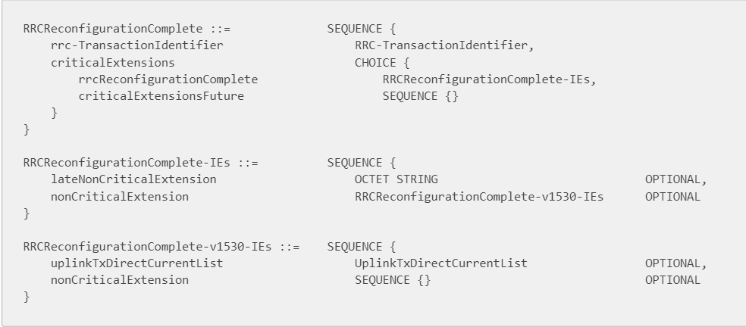

Slide 26
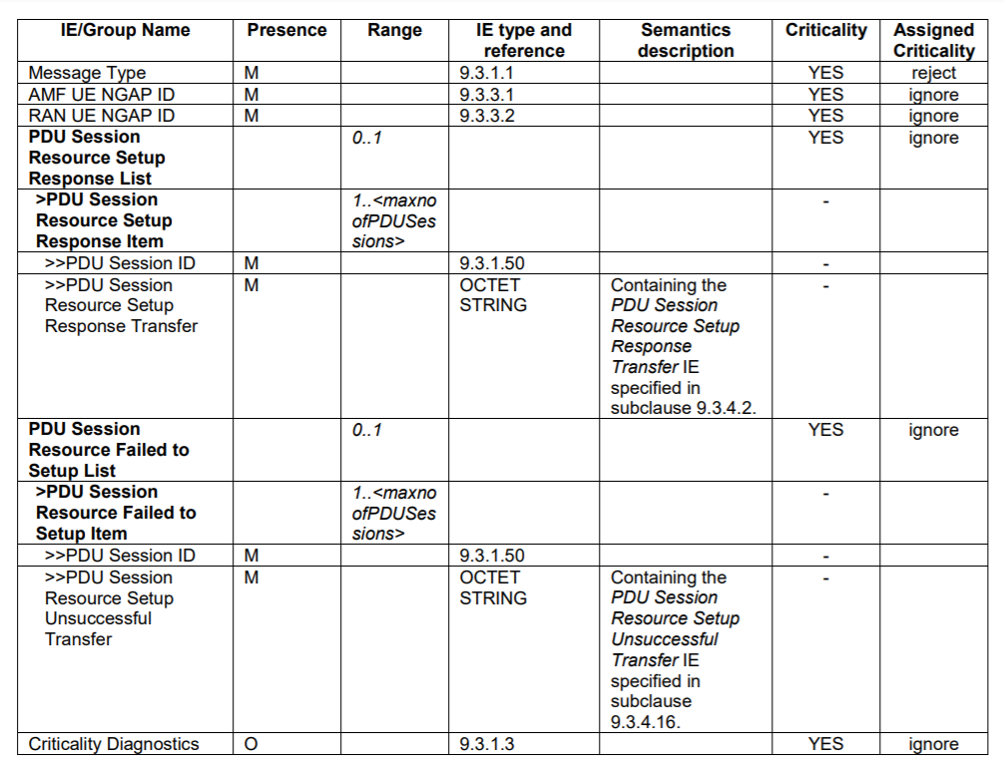
INITIAL CONTEXT SETUP RESPONSE

